Slide 1
SLAM based on the spotlight for retinal surgery
Kick off Presentation
Student: Jingsong Liu
Supervisor: Dr. Mingchuan Zhou
Additional Supervisors: Dr.-Ing. M. Ali Nasseri
Director: Prof. Nassir Navab

Slide 2
Introduction of robot-aided retinal surgery

Slide 3
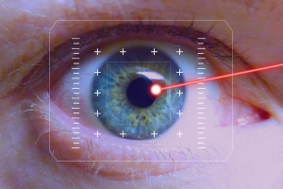
Retinal Surgery Challenges
High Requirements
High Precision
Controlled Movements
Many Limitations
Robot filter out hand tremors
Unwanted Movements (patients)
Hand tremor (surgeon)
Bad visibility
Spotlight localizes the instrument
Robot-assisted and Spotlight-based Retinal Surgery is of good significance.
Notes:
Due to limitations in the human motorical capabilities, retinal microsurgery is one of the most challenging surgical tasks. The challenges include the need for highly precise movements in a very small and fragile environment, which is also difficult to access. It is further hindered by poor visibility, movements of the patient and physiological hand tremor of the surgeon.

Slide 4
Related work of localization of Spotlight for retinal surgery

Slide 5
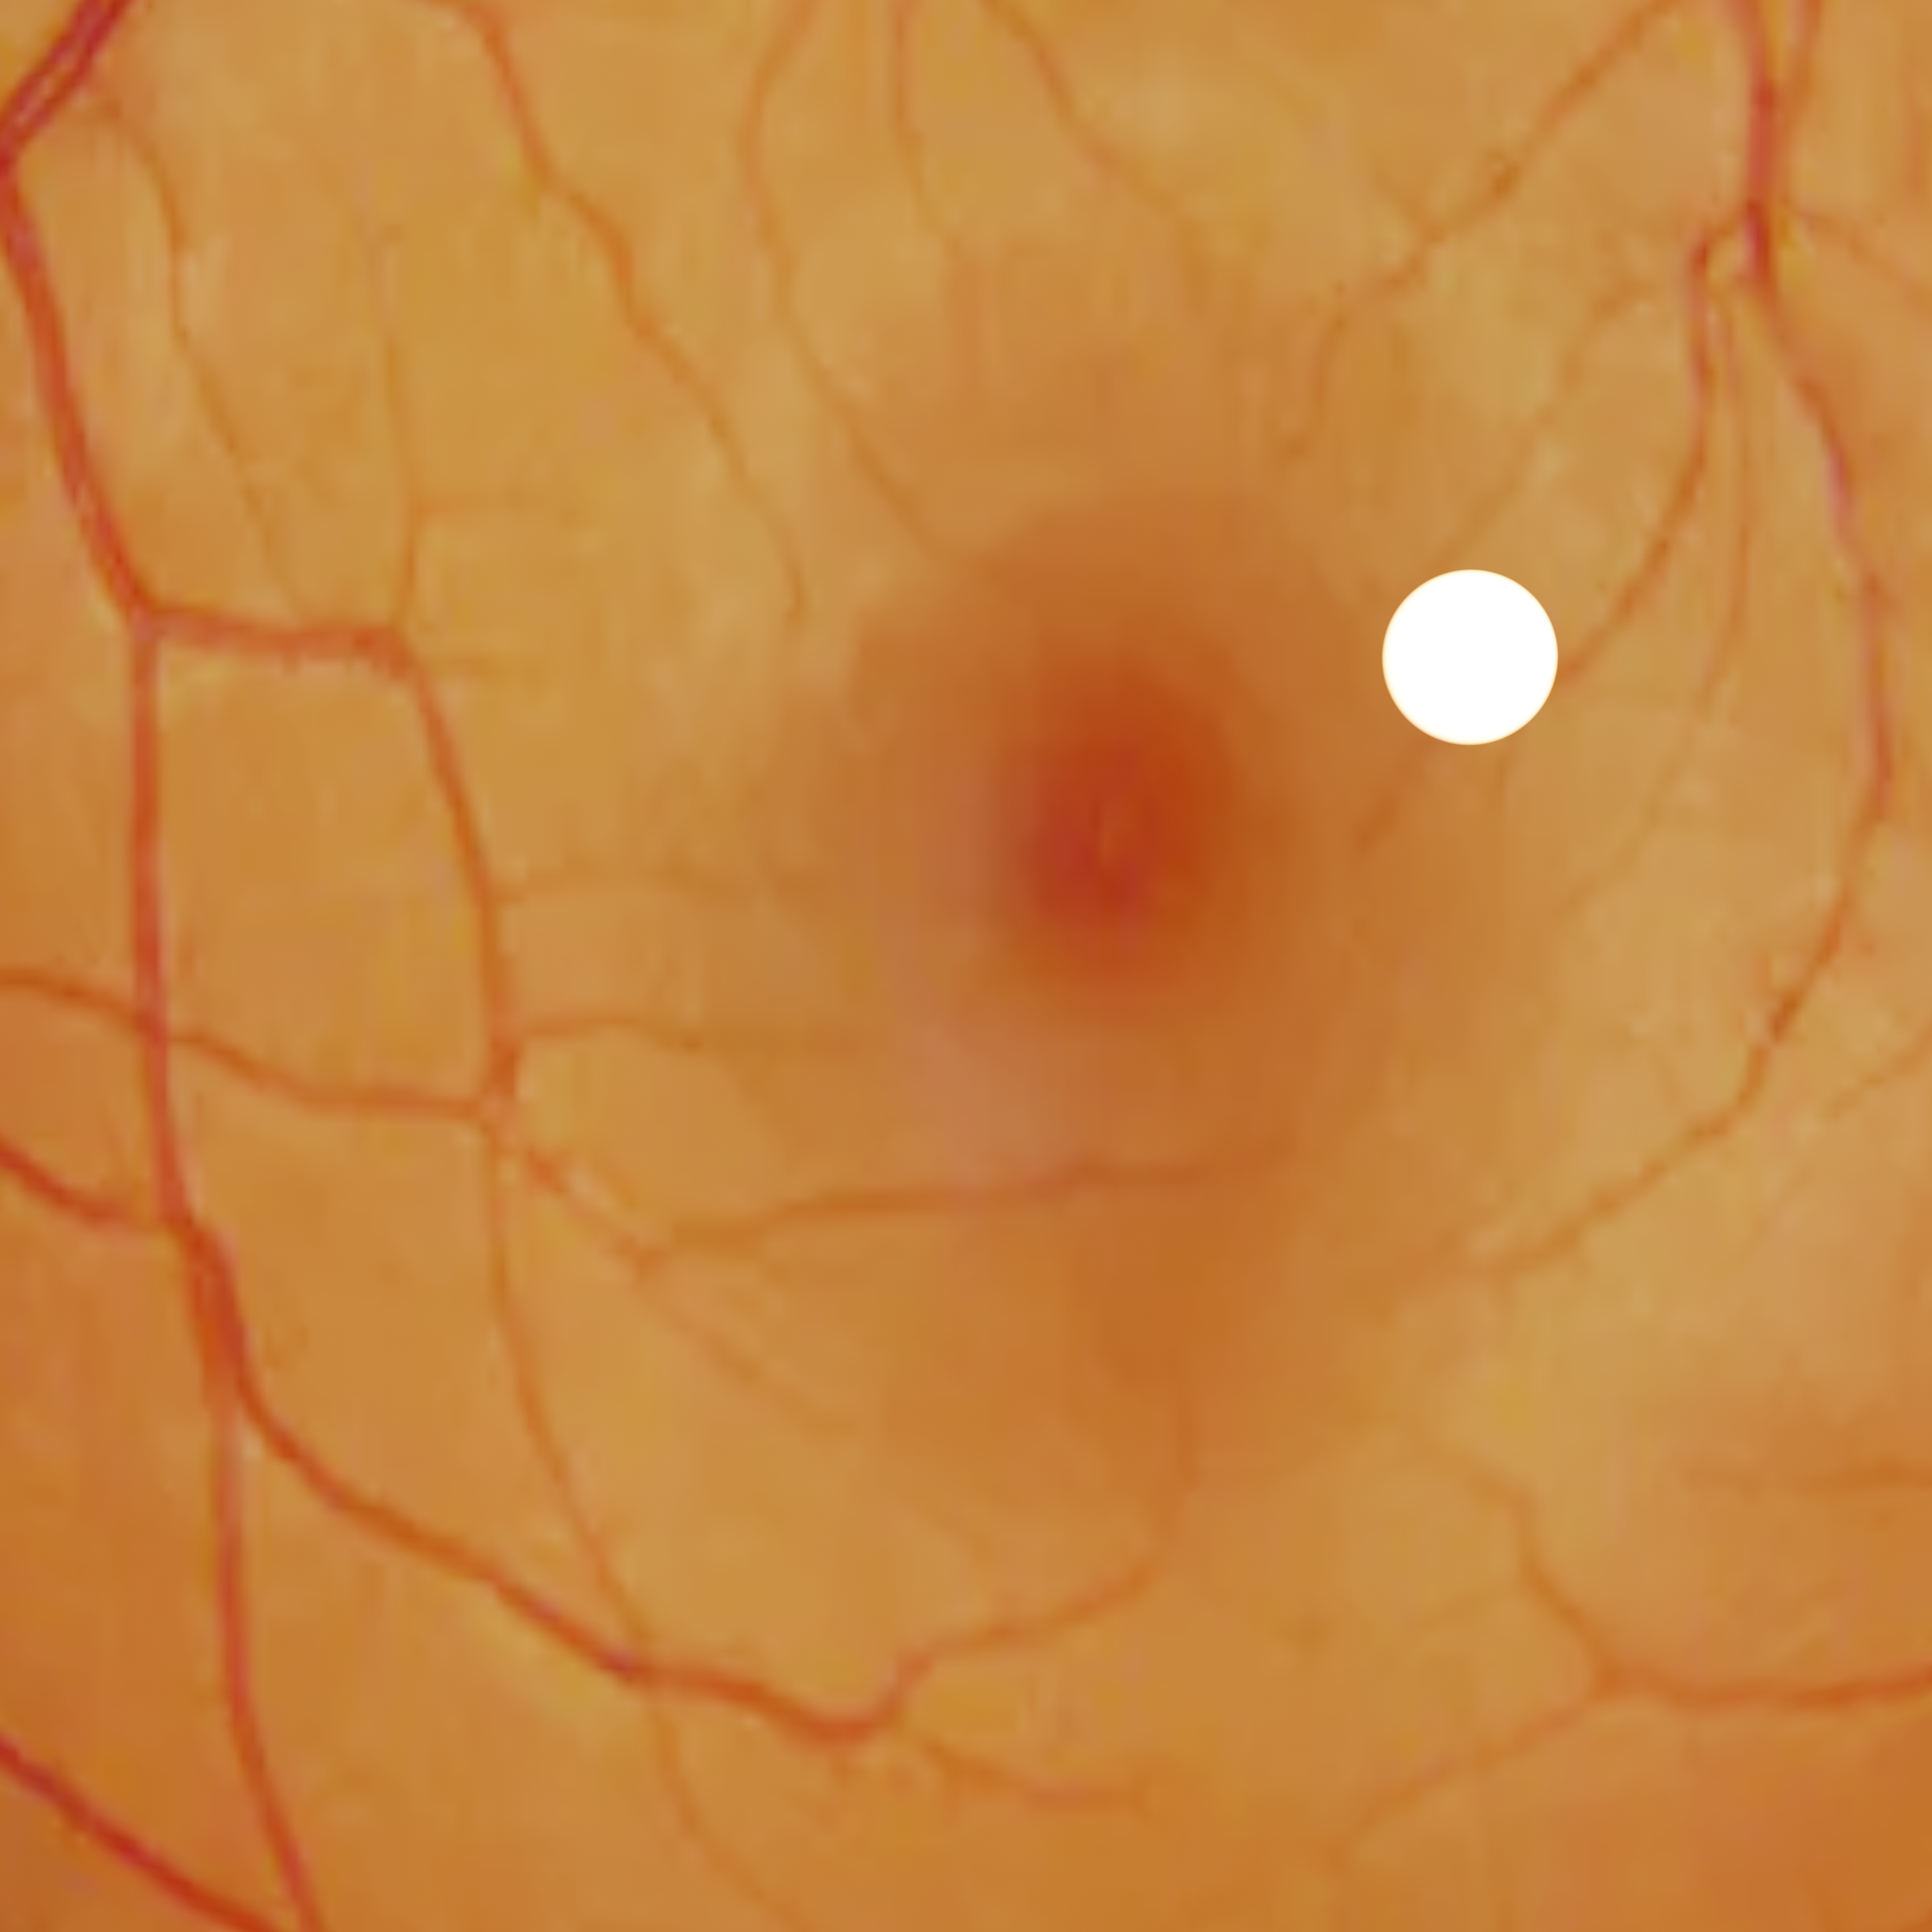
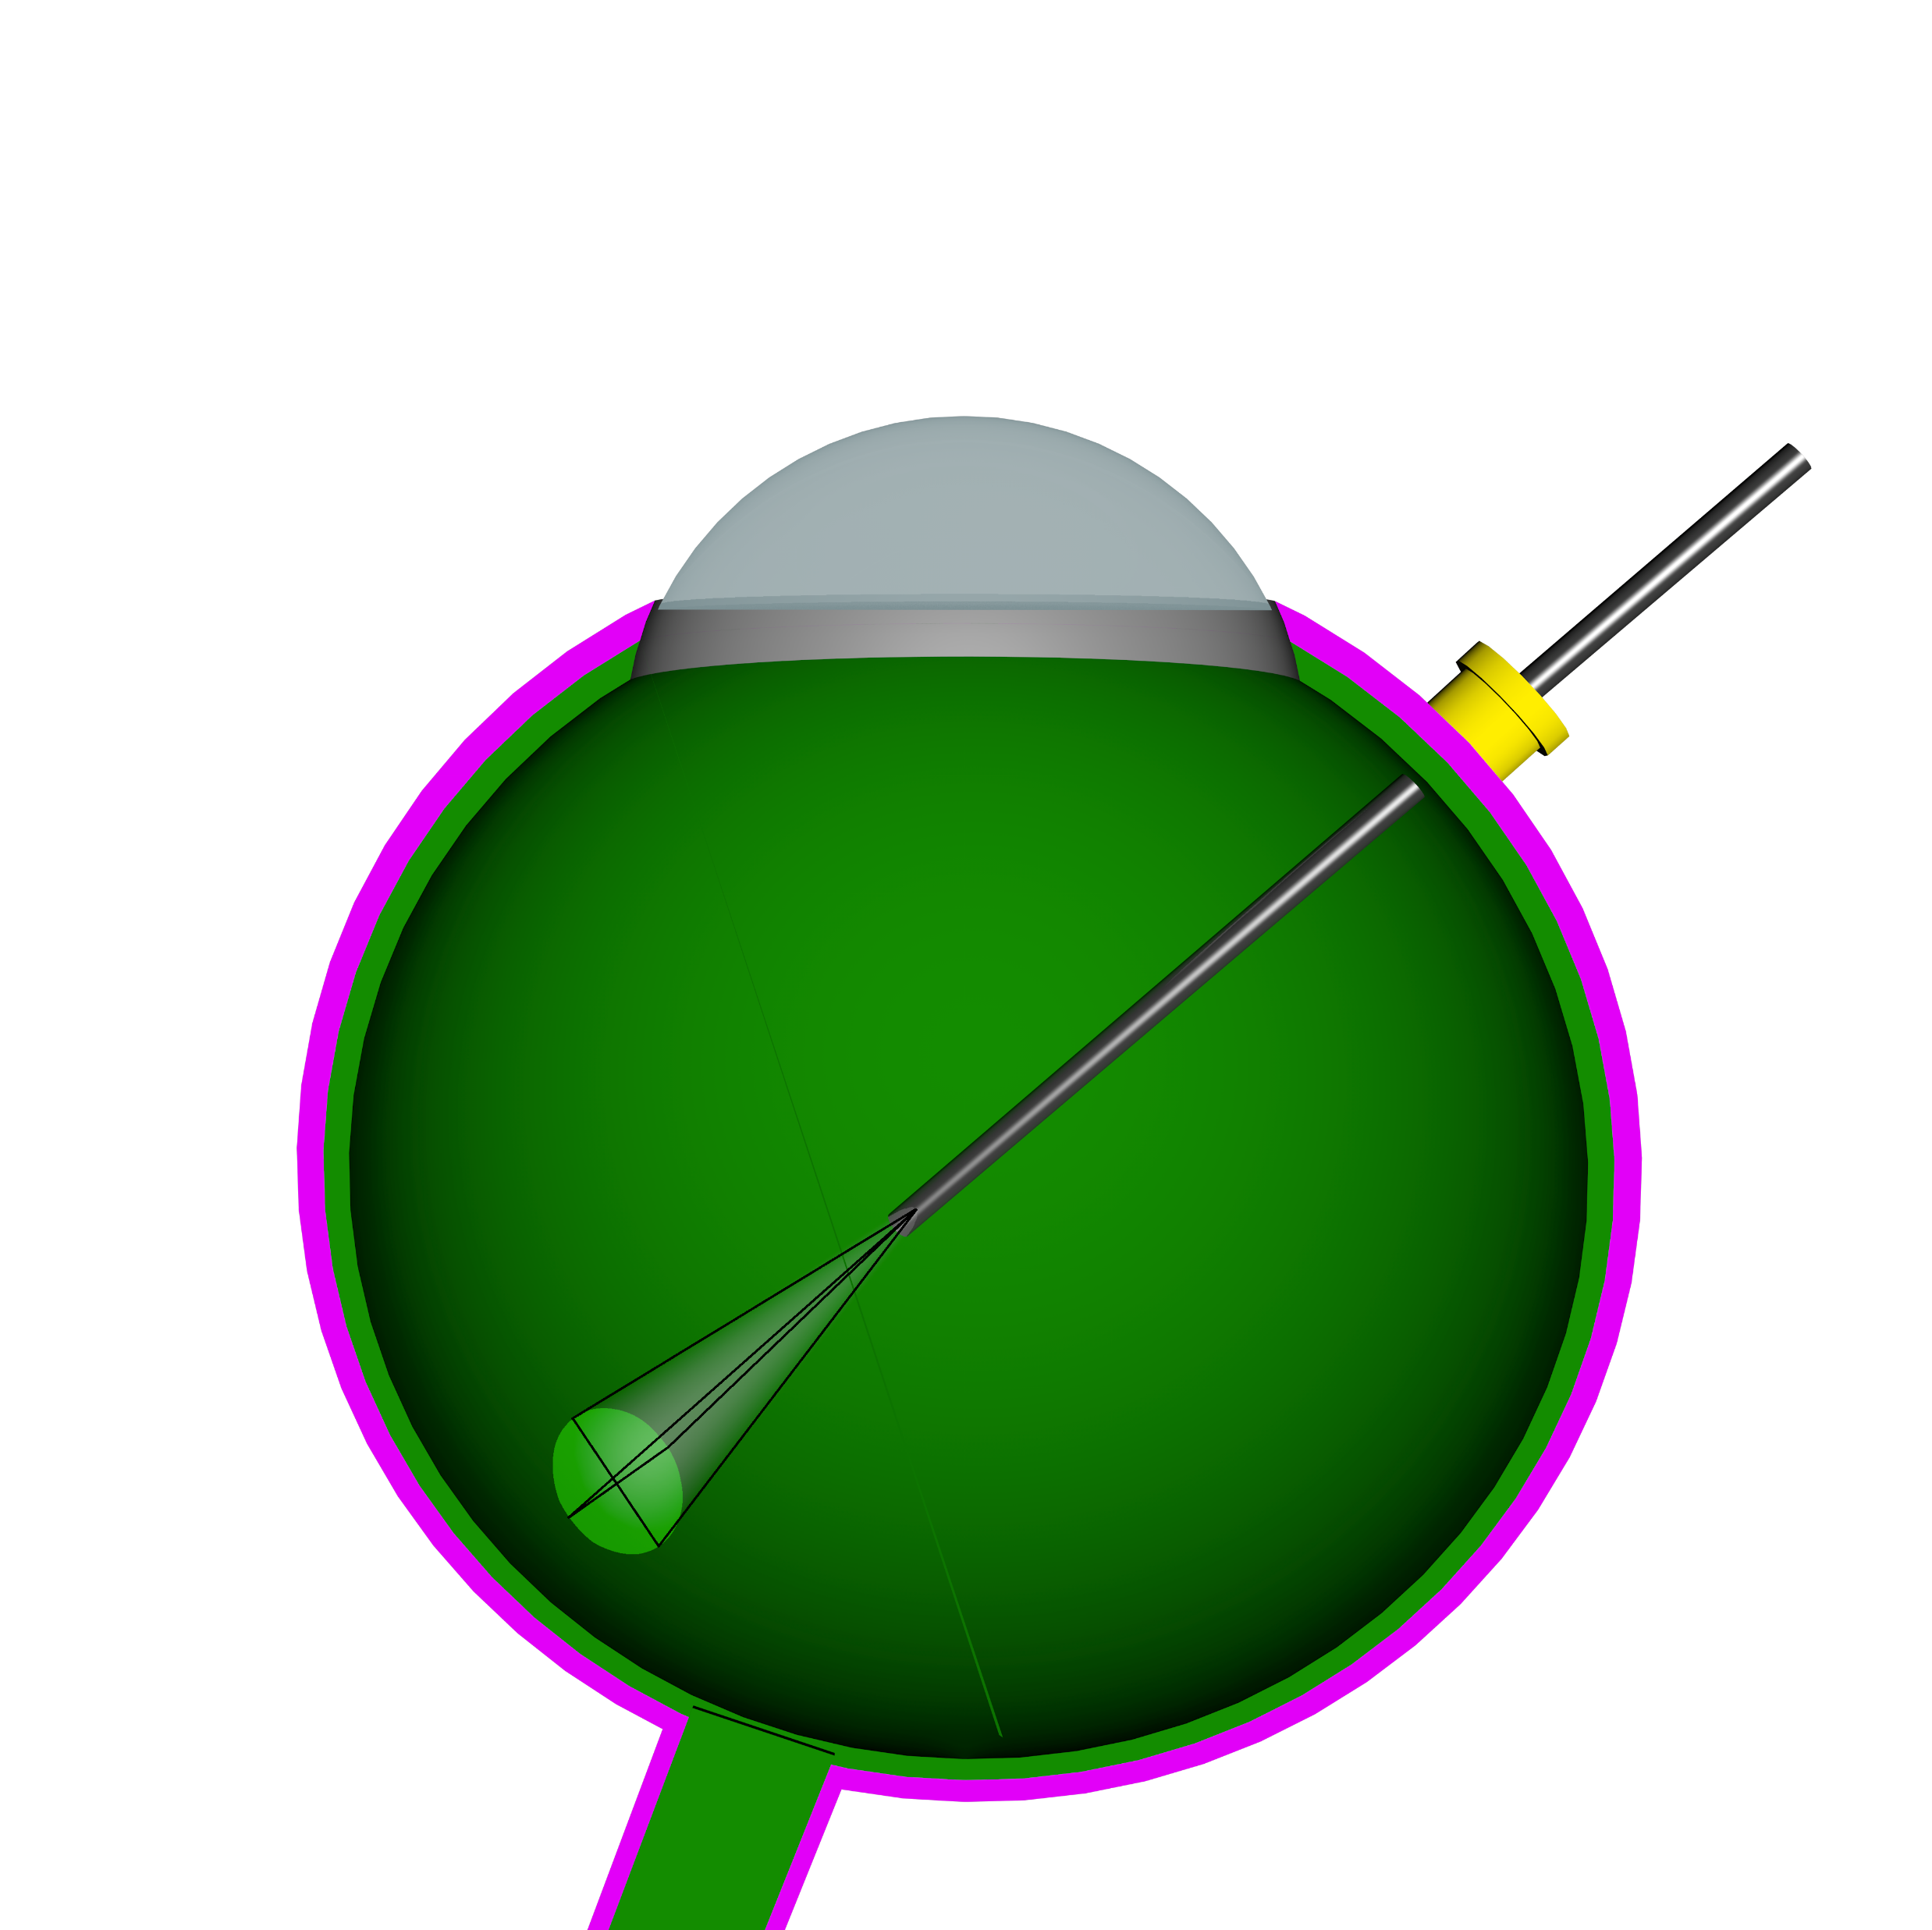



Spotlight-based Localization
previous work: Workflow
Camera sensor
Camera Image
Microscope
Instrument
Eye
Detected Contour
Reconstructed cone
Position of instrument
Resource: Mingchuan Zhou , Felix Hennerkes,Nassir Navab“Theoretical Error Analysis of Spotlight-based Instrument Localization for Retinal Surgery” RAL-ICRA (2021).

Slide 6
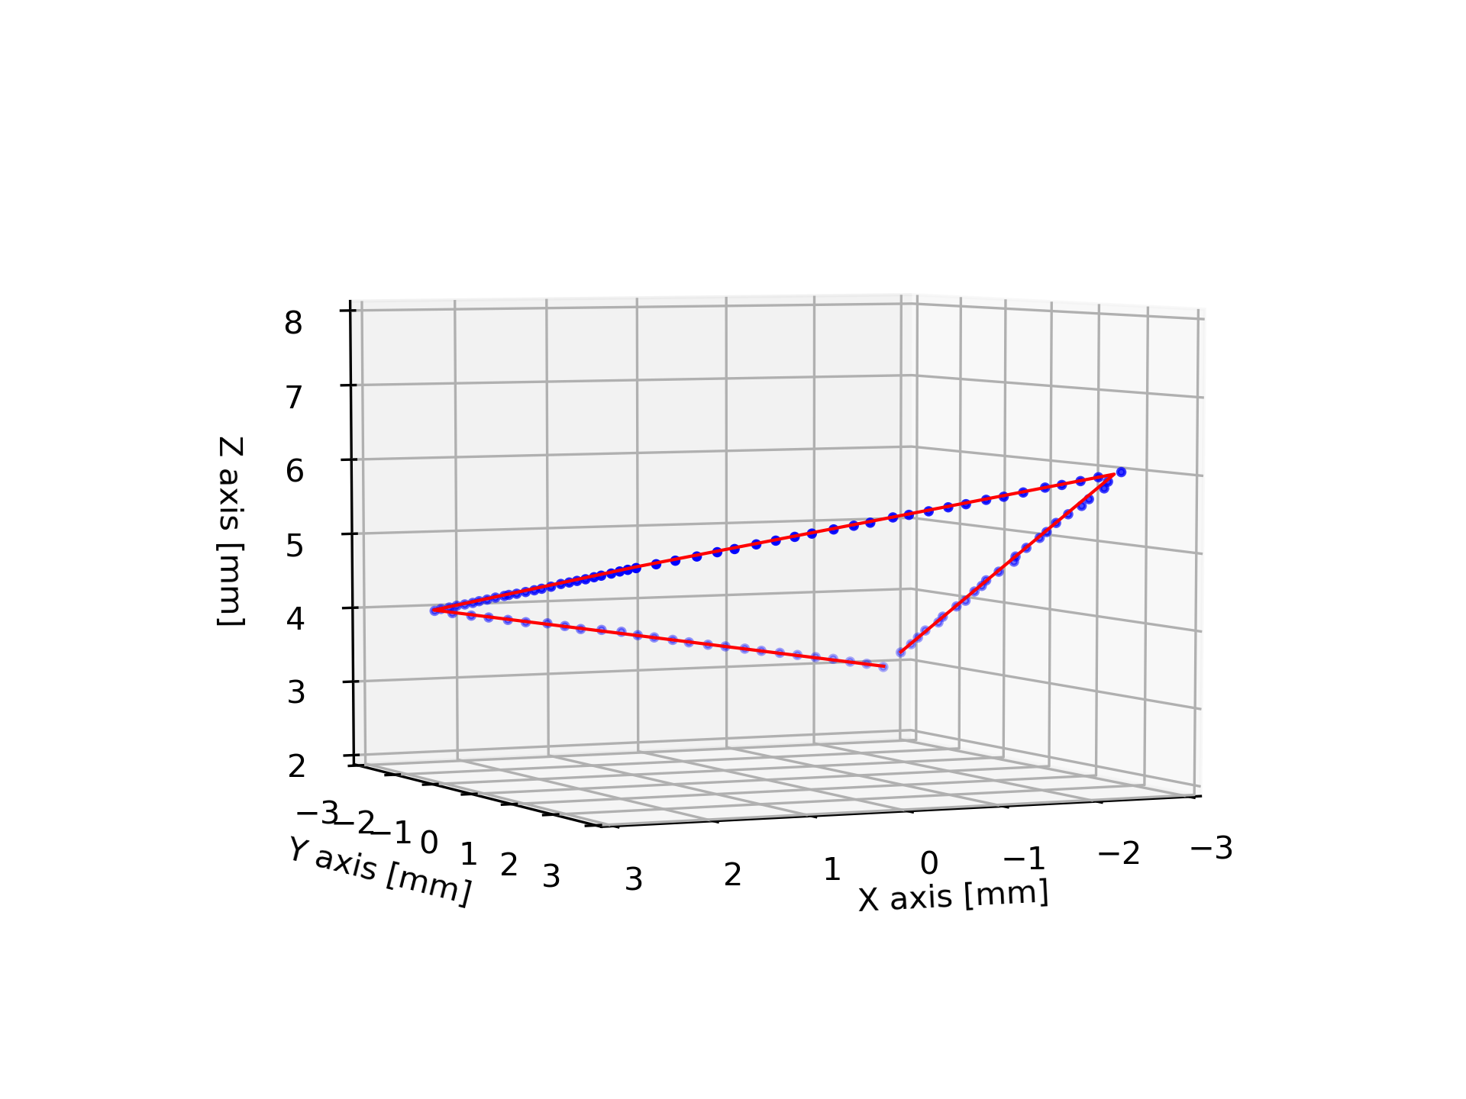
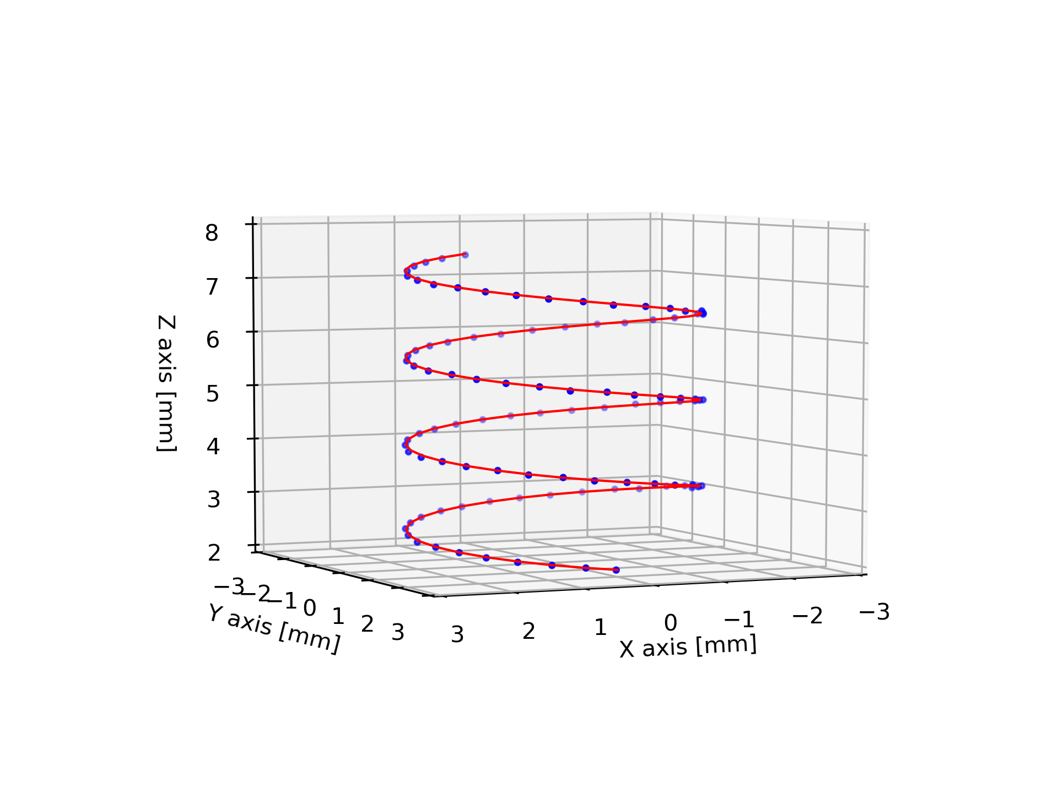
Spotlight-based Localization
previous work: Summary
 | Average Error [mm] | Maximum Error [mm]
Square (single) | 0.026 | 0.100
Helix (single) | 0.031 | 0.133
+ Good localization accuracy
- lack mapping, which can guarantee the safety of eyeball
SLAMapping
What will be done in the research
Resource: Mingchuan Zhou , Felix Hennerkes,Nassir Navab“Theoretical Error Analysis of Spotlight-based Instrument Localization for Retinal Surgery” RAL-ICRA (2021).
Notes:
Simulatinous localization and mapping, in the previous work the simulation and localization were finished and what will be done in this research is exactly mapping of retinal surface.

Slide 7
Related work of mapping and retinal reconstruction

Slide 8
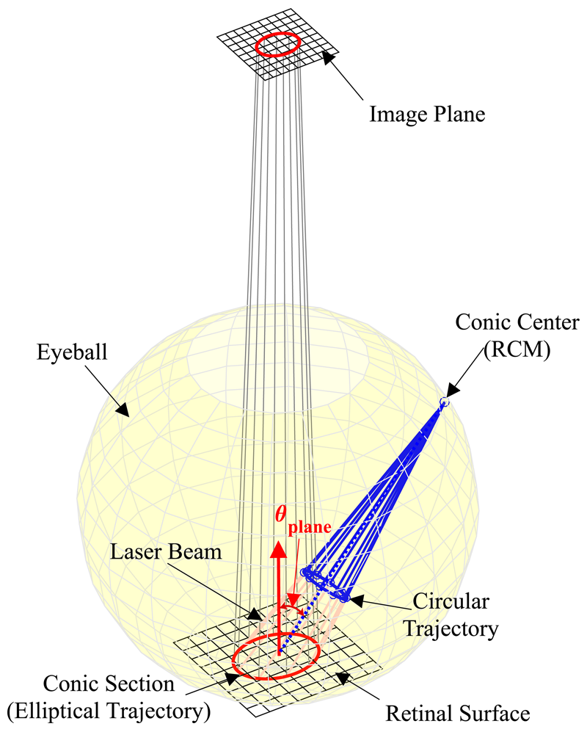
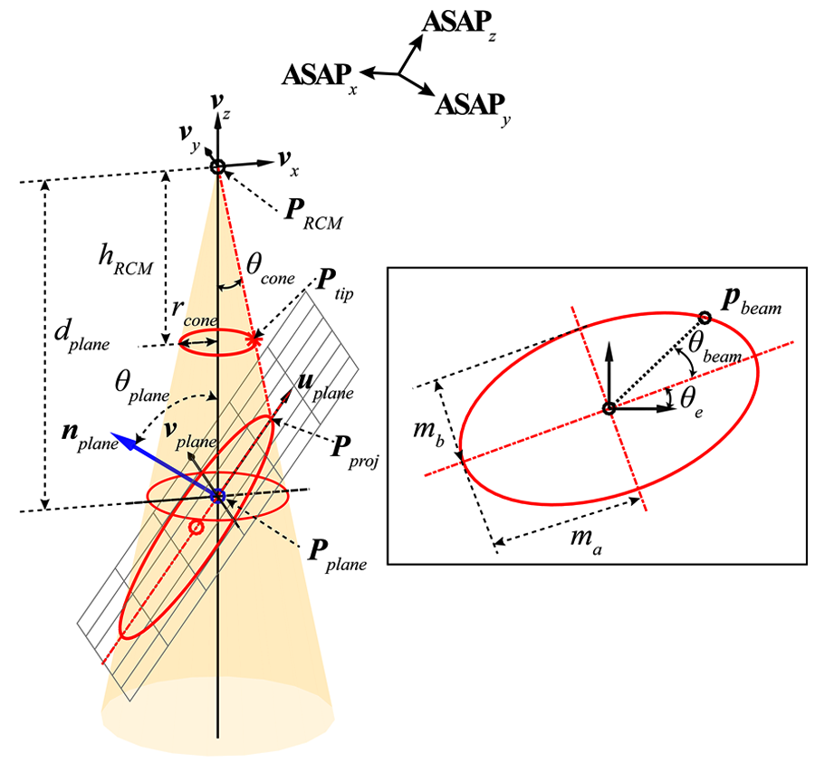
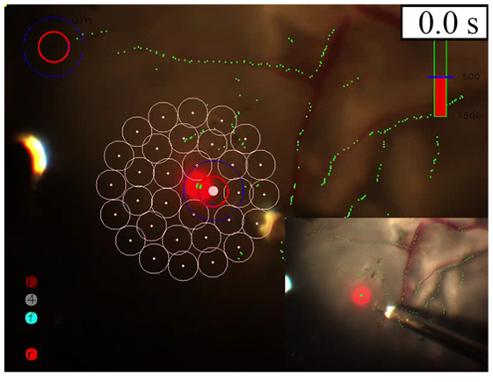
Retinal surface estimation using monocular vision
Surface Estimation using Projective Geometry
Conic section projects
on retinal surface
Cone beam analysis&
retinal surface estimation
Demonstration of intraocular laser surgery on estimated retinal surface
Resource: S. Yang, J. N. Martel, L. A. Lobes Jr, and C. N. Riviere, “Techniques for robot-aided intraocular surgery using monocular vision,” The International journal of robotics research, vol. 37, no. 8, pp. 931–952, 2018.
Notes:
Pink circles indicate preplanned targets lying on the inner surface of the eye phantom. The red solid circle on a current target represents a visual cue to maintain hand–eye coordination.

Slide 9
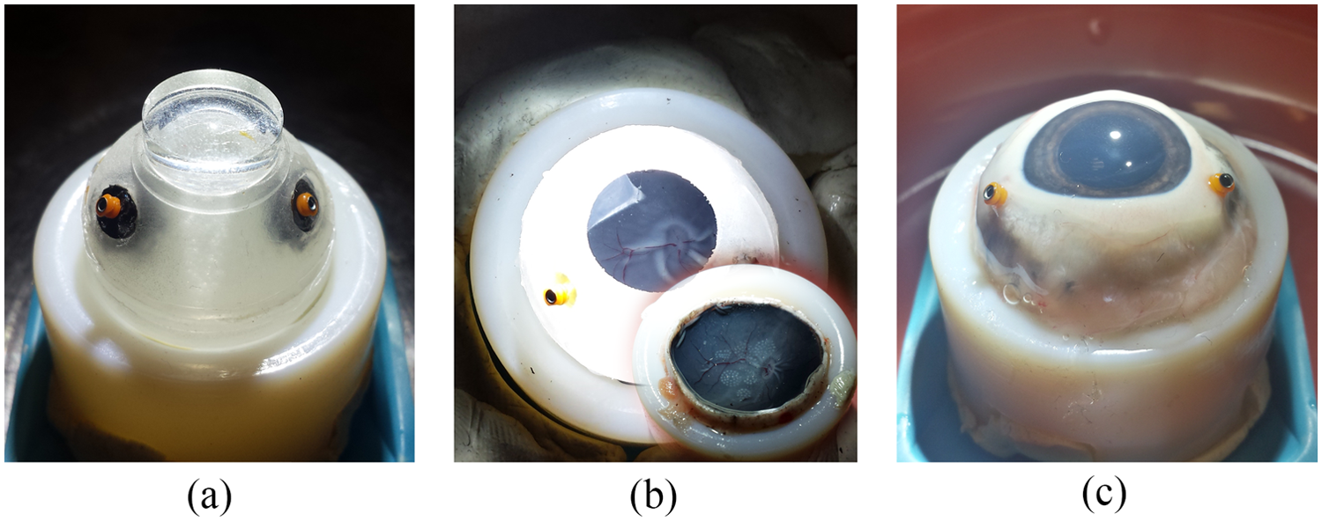
Retinal surface estimation using monocular vision
Experiments: Summary
Work with image visual serving | Average localization error [um]
Eye phantom | >50
Placed with dissected porcine eye | >70
Intact porcine eye | >70
(a) Eye phantom filled with water and covered with a contact lens.
(b) Dissected porcine eye placed inside the eye phantom without lens;
(c) Intact porcine eye with cornea for ex-vivo test
+ can achieve good accuracy when work with image visual serving
- accuracy of surface estimation alone is very poor (>600um)
- the estimated retina surface is just a plane, far different from realistic
3D Point Cloud Mapping
Resource: Mingchuan Zhou , Felix Hennerkes,Nassir Navab“Theoretical Error Analysis of Spotlight-based Instrument Localization for Retinal Surgery” RAL-ICRA (2021).
Notes:
What was great with the research is that lots of experiments were designed to verify the accuracy of the surface estimation method. Here are three diff experiment materials.

Slide 10
What will be done?

Slide 11
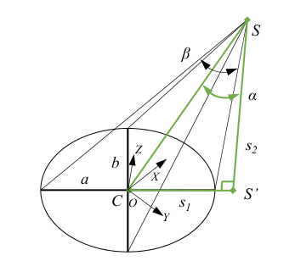
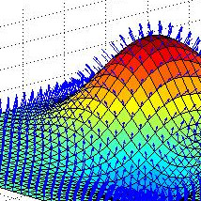
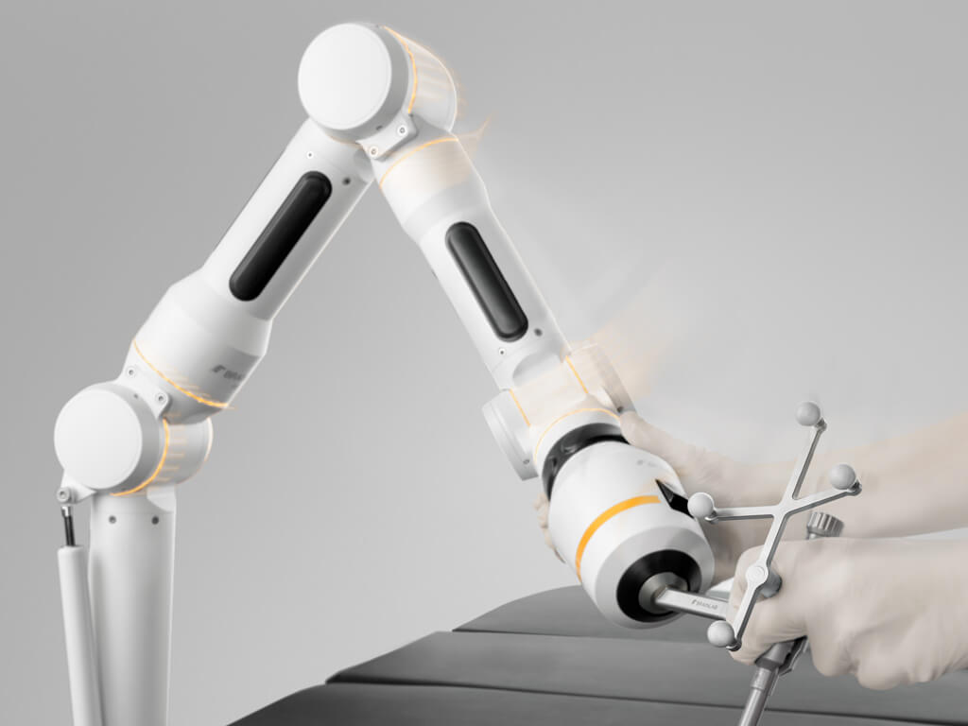
SLAM based on the spotlight for retinal surgery
Instruments’ position and pose (given by robot platform)
Relative position of projected ellipse center
Coordinates of points on surface relative to world
+
Resource: https://www.eu-startups.com/2019/03/munich-based-brainlab-acquires-medtech-startup-medineering-to-scale-its-robotic-surgery-solutions/.

Slide 12
Resources

Slide 13
Sources
[1] Mingchuan Zhou , Felix Hennerkes,Nassir Navab“Theoretical Error Analysis of Spotlight-based Instrument Localization for Retinal Surgery” RAL-ICRA (2021)..
[2] G. Bradski. “The OpenCV Library.” In: Dr. Dobb’s Journal of Software Tools (2000).
[3] B. O. Community. Blender - a 3D modelling and rendering package. Blender Foundation. Stichting Blender Foundation, Amsterdam, 2018.
[4] W. H. Organization. World report on vision. Tech. rep. World Health Organization, 2019.
[5] A. Routray, R. A. MacLachlan, J. N. Martel, and C. N. Riviere. “Real-Time Incremental Estimation of Retinal Surface Using Laser Aiming Beam.” In: 2019 International Symposium on Medical Robotics (ISMR). 2019, pp. 1–5. 59 Bibliography
[6] S. Yang, J. N. Martel, L. A. Lobes Jr, and C. N. Riviere. “Techniques for robotaided intraocular surgery using monocular vision.” In: The International journal of robotics research 37.8 (2018), pp. 931–952.
[7]Braun D, Yang S, Martel JN, et al. EyeSLAM: Real-time localization and mapping of retinal vessels during intraocular microsurgery. International Journal of Medical Robotics and Computer Assisted Surgery 14(1): e1848.(2018)
[8]Yang S, MacLachlan RA, Martel JN, et al. Comparative evaluation of handheld robot-aided intraocular laser surgery. IEEE Transactions on Robotics 32(1): 246–251.(2016)

